Slide 1
Advanced Java Programming
Introduction to Frameworks

Slide 2
Introduction
Java web frameworks have revolutionized the way web applications are developed in the Java ecosystem.
These frameworks provide a structured and efficient approach to building robust, scalable, and maintainable web applications.
With the wide array of options available, developers can choose a framework that best suits their project requirements and development style.

Slide 3
What is a Framework?
In Java, a framework is a pre-designed and reusable software structure that provides a foundation for developing applications.
It offers a set of libraries, tools, and conventions that guide developers in building applications more efficiently by abstracting common functionalities and promoting a structured approach.

Slide 4
What is a Framework?
A framework provides a structured environment where developers can focus on implementing the specific business logic of their application rather than dealing with low-level details.
It offers ready-made solutions for common tasks, such as handling requests, managing data persistence, implementing security features, and more.

Slide 5
What is a Framework?
In simple words, a framework is like a ready-made toolkit that helps developers build applications more easily.
It provides a set of tools, rules, and pre-built components that make development faster and more efficient.
Think of it like a construction kit for building a house. Instead of starting from scratch and figuring out every little detail, you get a framework that already has the foundation, walls, and basic structure in place. This allows you to focus on customizing and adding your own unique features rather than worrying about the basic construction.

Slide 6
What is a Framework?
For example, the Spring Framework is like a popular framework for Java applications.
It provides a set of tools and rules that help developers handle common tasks like managing data, handling web requests, and connecting to databases.
By using the Spring Framework, developers can save time and effort because they don't have to build these functionalities from scratch.

Slide 7
Advantages of Using Frameworks
Using frameworks in Java has several benefits that make development easier and more efficient.
Faster Development:
Frameworks provide pre-built tools and components that save time by reducing the amount of code developers need to write from scratch.
This means developers can focus more on creating unique features for their application instead of dealing with repetitive tasks.

Slide 8
Advantages of Using Frameworks
Using the Spring Framework, developers can quickly create a web application by leveraging its pre-built components.
For example, instead of writing code to handle database connectivity, Spring provides the Spring JDBC module. With just a few lines of code, developers can establish a database connection and perform CRUD (Create, Read, Update, Delete) operations, saving time and effort.

Slide 9
Advantages of Using Frameworks
Reusability:
Frameworks offer ready-made modules that can be used across different projects.
Developers can take advantage of these modules, saving effort and maintaining consistency in their code.
It's like using pre-designed Lego pieces instead of building everything from individual bricks.

Slide 10
Advantages of Using Frameworks
Reusability:
In a Java web application built with the Struts framework, developers can reuse custom UI components across different pages.
For instance, if there is a custom login form with validation logic, it can be defined once and used on multiple pages throughout the application.
This ensures consistency and reduces redundant code.

Slide 11
Advantages of Using Frameworks
Best Practices:
Frameworks follow established guidelines and industry standards, which ensures that developers are using tried and tested methods.
This promotes code quality, makes collaboration easier, and helps developers write cleaner and more maintainable code.

Slide 12
Advantages of Using Frameworks
Best Practices:
When using Hibernate, an ORM framework, developers can define their data models using annotations or XML mappings.
Hibernate automatically generates SQL queries for database operations based on these mappings.
This encourages developers to follow the best practice of separating business logic from database operations and helps maintain a clean and organized code structure.

Slide 13
Advantages of Using Frameworks
Easy Maintenance:
Frameworks promote clean and organized code structure, making it easier to maintain and update applications in the future.
This ensures that the code remains readable and understandable, even as the project grows.

Slide 14
Advantages of Using Frameworks
Scalability:
Frameworks are designed to handle the growth of applications.
They provide tools and techniques to manage increased traffic and handle concurrent requests.
This allows developers to build applications that can handle more users without sacrificing performance.

Slide 15
Advantages of Using Frameworks
Scalability:
With the help of the scalability features provided by frameworks like Spring Boot, developers can handle increased traffic to their applications.
For example, Spring Boot allows easy integration with cloud platforms and provides features like load balancing and clustering.
Developers can scale their applications horizontally by adding more instances to handle higher user loads.

Slide 16
Popular Java Web Frameworks
Spring Framework:
Spring is a popular Java framework that makes it easier to build web applications.
It provides a wide range of tools and features to simplify development.
For example, it helps manage different parts of an application, such as connecting to databases, handling web requests, and managing dependencies between components.
Spring takes care of many common tasks, allowing developers to focus on writing the specific code that makes their application unique.

Slide 17
Popular Java Web Frameworks
Spring Boot:
Spring Boot is a specialized version of the Spring Framework that makes it even easier to create web applications.
It reduces the amount of configuration needed by providing sensible defaults. This means developers don't have to spend as much time setting up the project and can quickly get their application up and running.
Spring Boot takes care of many common configurations automatically, so developers can focus on writing the core logic of their application.

Slide 18
Popular Java Web Frameworks
Hibernate:
Hibernate is a framework that simplifies working with databases in Java applications.
It allows developers to store and retrieve data from a database using regular Java objects instead of writing complex SQL queries.
Hibernate takes care of the translation between Java objects and database tables, making it easier to work with databases and reducing the amount of repetitive code that needs to be written.

Slide 19
Popular Java Web Frameworks
Java Server Faces (JSF):
JSF is a framework that makes it easier to create user interfaces for web applications.
It provides a set of pre-built UI components that developers can use to build the different parts of their application's user interface, such as buttons, forms, and tables.
JSF takes care of rendering these components and handling user interactions, making it simpler to create interactive web pages.

Slide 20
Popular Java Web Frameworks
Apache Struts:
Struts is a framework that follows the Model-View-Controller (MVC) design pattern.
It helps structure web applications into separate components that handle different responsibilities. The "model" represents the data and business logic, the "view" displays the user interface, and the "controller" handles user input and coordinates the flow of information between the model and view.
Struts provides tools and features to simplify building applications following this pattern.

Slide 21
Popular Java Web Frameworks
Google Web Toolkit (GWT):
GWT is a framework that allows developers to write web applications using Java and then converts that code into optimized JavaScript that can run in web browsers.
It simplifies the development process by providing tools and libraries that handle cross-browser compatibility and optimize the performance of the application.
With GWT, developers can write code in Java, which is a familiar and widely-used language, and still create web applications that work well in different browsers.

Slide 22
Popular Java Web Frameworks
Google Web Toolkit (GWT):
GWT is a framework that allows developers to write web applications using Java and then converts that code into optimized JavaScript that can run in web browsers.
It simplifies the development process by providing tools and libraries that handle cross-browser compatibility and optimize the performance of the application.
With GWT, developers can write code in Java, which is a familiar and widely-used language, and still create web applications that work well in different browsers.

Slide 23
Comparison of Java Web Frameworks
Aspect | Hibernate | Struts | Spring | Spring Boot | JSF
Type | ORM Framework | MVC Web Framework | Comprehensive Application Framework | Simplified and Opinionated Spring Framework | Component-based Web Framework
Purpose | Object-Relational Mapping for Database interactions | Building web applications and managing UI components | Developing Java-based applications across domains | Building stand-alone and production-ready applications | Creating user interfaces for web applications
Key Features | ORM Mapping | MVC Architecture | Dependency Injection (IoC) | Auto-configuration | Rich UI Components and Event Handling

Slide 24
Comparison of Java Web Frameworks
Aspect | Hibernate | Struts | Spring | Spring Boot | JSF
Key Features | Caching and Query Optimization | Form Handling and Validation | Aspect-Oriented Programming (AOP) | Embedded Web Server | Automatic State Management
 | Lazy Loading | Routing and Request Handling | Security and Authentication | Spring Actuator for monitoring and management | Templating and Custom Components
 | Transactions and Concurrency Management | Interceptors and Global Exception Handling | Batch Processing | Externalized Configuration and Properties Management | Integration with AJAX and Web Services

Slide 25
Comparison of Java Web Frameworks
Aspect | Hibernate | Struts | Spring | Spring Boot | JSF
Use Cases | Building database-driven Java applications | Legacy applications and projects | Enterprise-level applications | Microservices and Cloud-native applications | Web-based applications with dynamic UI
Learning Curve | Moderate | Moderate | Moderate to High | Low to Moderate | Moderate to High
Community | Strong community support | Moderate community support | Strong community and ecosystem support | Strong community and ecosystem support | Moderate community support

Slide 26
Comparison of Java Web Frameworks
Aspect | Hibernate | Struts | Spring | Spring Boot | JSF
Popularity | Widely used | Decreasing popularity due to newer frameworks | Widely used and established in enterprise applications | Widely adopted for microservices and cloud applications | Used in certain enterprise and government projects
Active | Actively maintained and updated | Less actively maintained | Actively maintained and updated | Actively maintained and updated | Actively maintained and updated

Slide 27
Environmental Setup for Web Framework Development
Install Java Development Kit (JDK)
Choose an Integrated Development Environment (IDE)
Eclipse IDE for Enterprise Java and web developers
Set up a Build Tool
Maven
Install a Web Server or Container
Tomcat server
Set up Database Software
mySql
Framework-Specific Tools and Dependencies
Spring Tool Suite (STS) for Spring projects or Hibernate plugins for ORM support

Slide 28
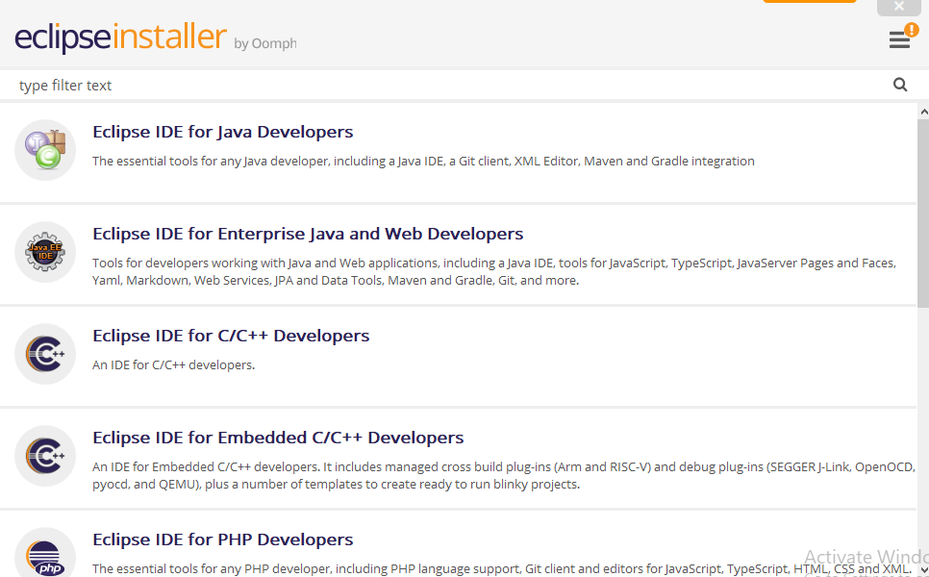
Environmental Setup for Web Framework Development

